Slide 1
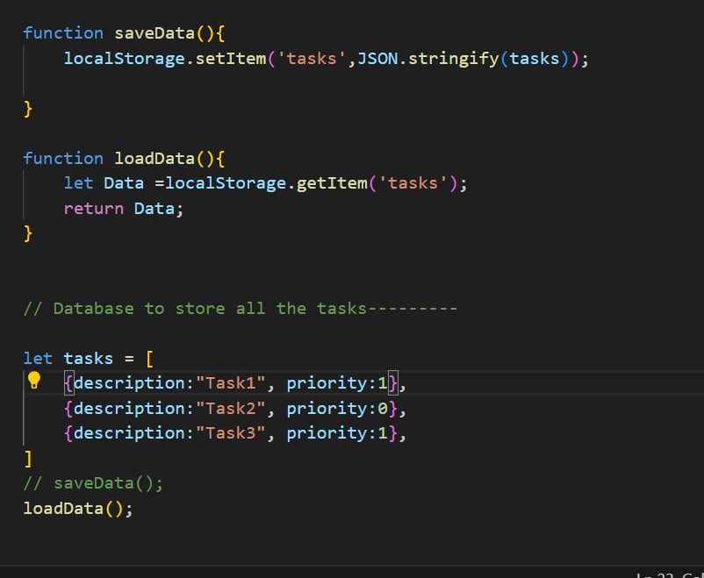
Data sructure
Step1 : create variable like this
Let tasks=[
{description:"Task1", priority:1},
{description:"Task2", priority:0},
{description:"Task3", priority:1},
]
Step2: take name of variable above to localStorage
Step3: take name of variable to variable

